Slide 1
Paper Review
LogConcDEAD / fmlogcondens
최정인

Slide 2
INDEX
01 LogConcDEAD
02 An Implementation of Shor’s r-Algorithm
03 Source code of LogConcDEAD
04 Fast multivariate log-concave density estimation
05 Source code of fmlogcondens

Slide 3
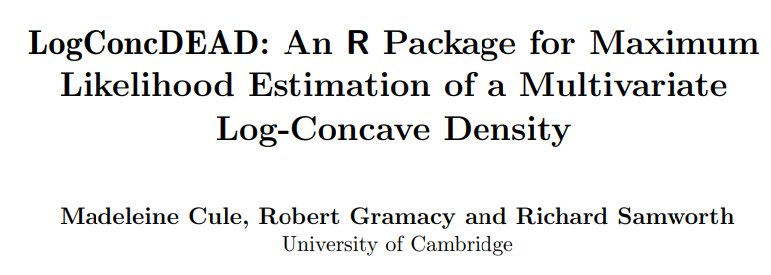
01

Slide 4
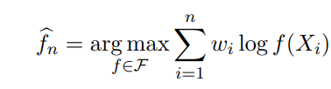
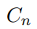
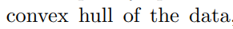
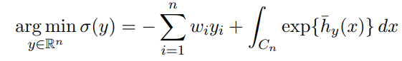
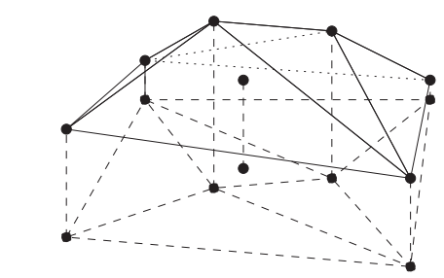
Paper Review
01. LogConcDEAD
:
‘Tent-like’ structure
Notes:
심리학에서 나온 자극-반응의 이론을 토대로,

Slide 5
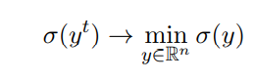
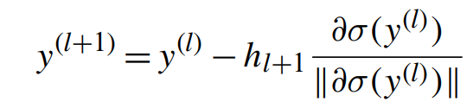
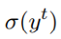
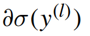
Paper Review
01. LogConcDEAD
At each iteration, the algorithm requires the evaluation σ(y t ), and the ∂σ(y t ), , which determines the direction of the move to the next term y t+1 in the sequence.
Notes:
심리학에서 나온 자극-반응의 이론을 토대로,

Slide 6
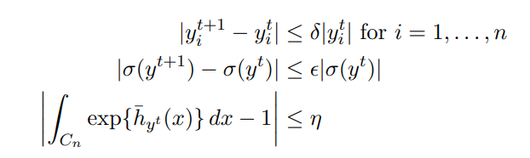
Paper Review
01. LogConcDEAD
Stopping criteria
ytol
sigmatol
integraltol
Notes:
심리학에서 나온 자극-반응의 이론을 토대로,

Slide 7
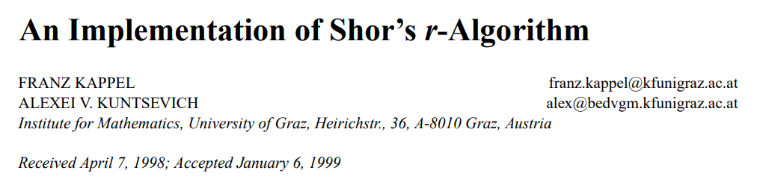
02

Slide 8
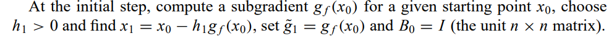
2. Shor’s r-algorithm
The main idea of the algorithm is to make steps in the direction opposite to a sub-gradient at the current point. However, the steps are to be made in the transformed space.

Slide 9
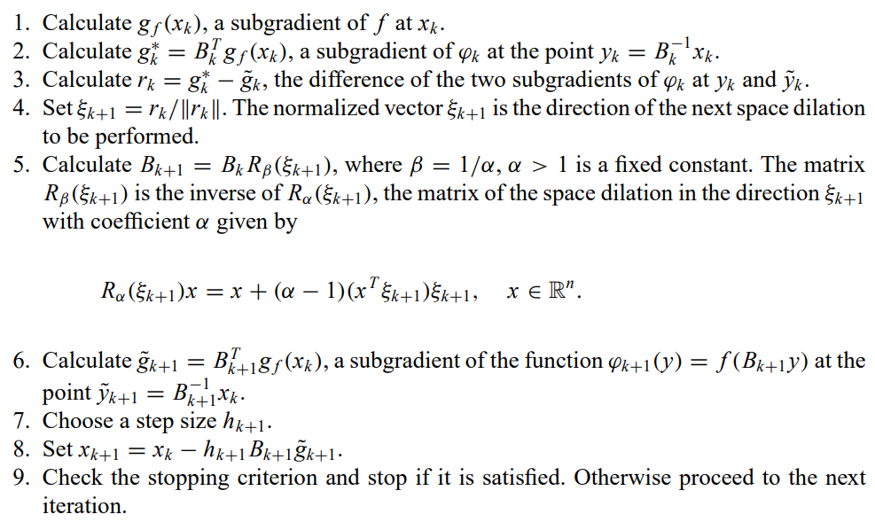
2. Shor’s r-algorithm
The main idea of the algorithm is to make steps in the direction opposite to a sub-gradient at the current point. However, the steps are to be made in the transformed space.
* difference between a subgradient at the current and previous point

Slide 10
03
Source code of LogConcDEAD

Slide 11
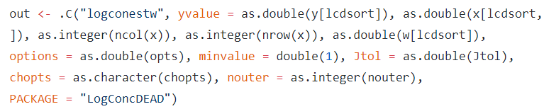
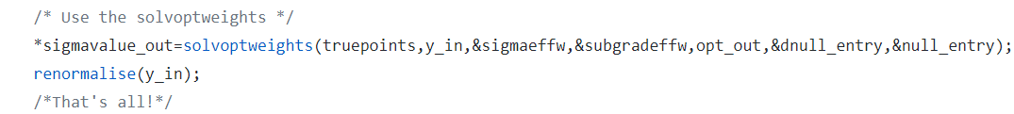
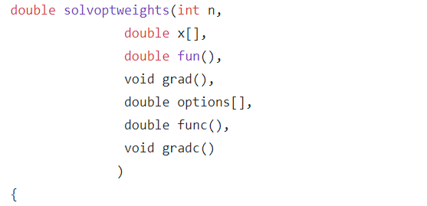
Notes:
심리학에서 나온 자극-반응의 이론을 토대로,

Slide 12
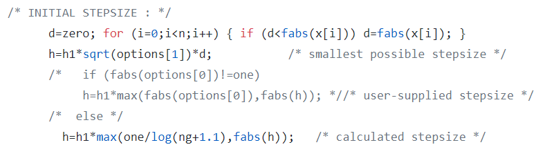
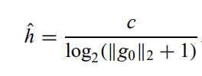
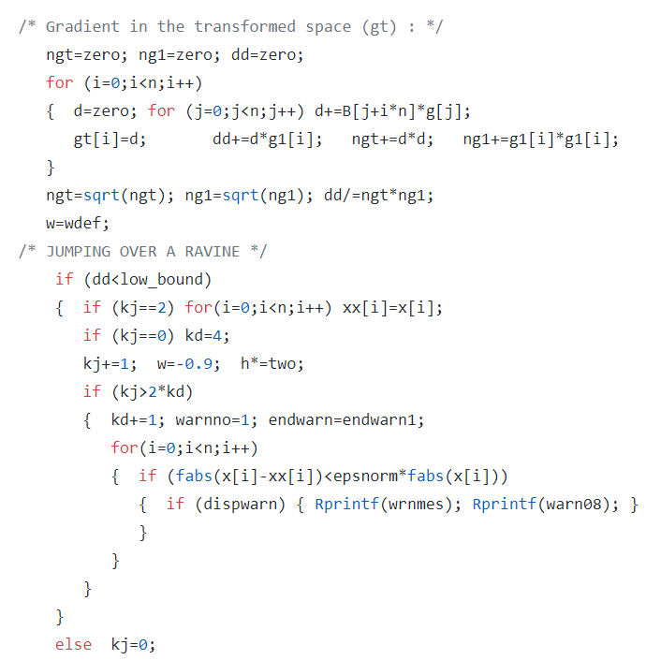
Notes:
심리학에서 나온 자극-반응의 이론을 토대로,

Slide 13
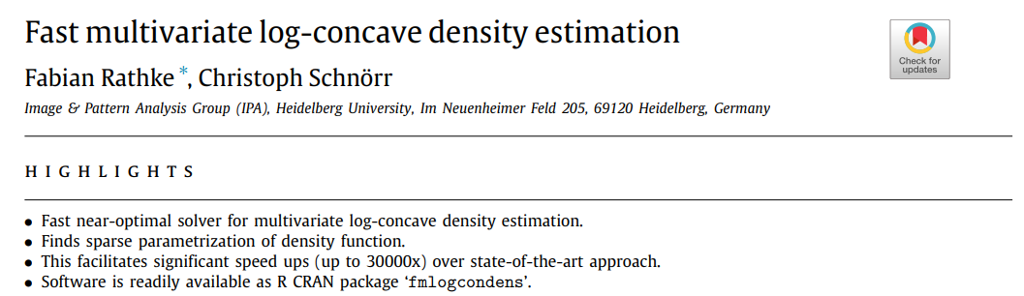
04

Slide 14
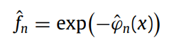
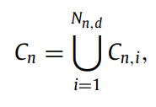
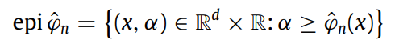
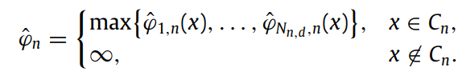
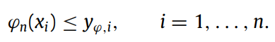
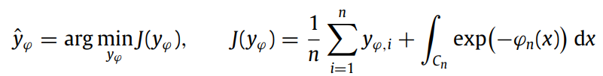
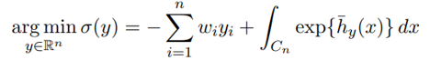
Notes:
심리학에서 나온 자극-반응의 이론을 토대로,

Slide 15
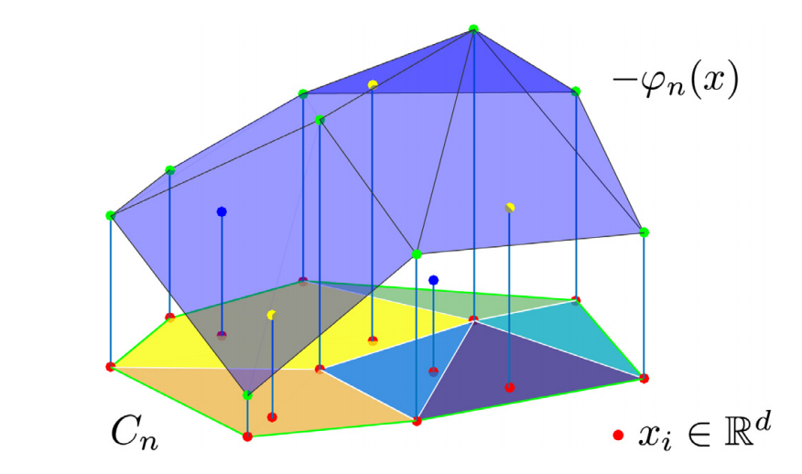
The objective function J is convex but non-smooth. As consequence, the iterative scheme is based on subgradients which are known to converge rather slowly.
The integral has to be evaluated in every iterative step for each subset Cn. While this can be conveniently done in closed form, it is the increasing number of these subsets for larger dimension d > 2 that slows down the algorithm
Notes:
심리학에서 나온 자극-반응의 이론을 토대로,

Slide 16
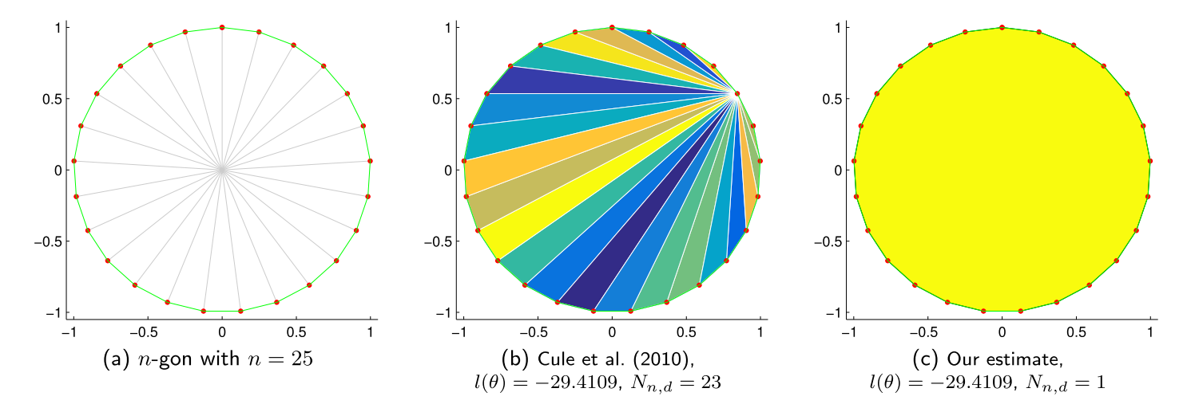
We consider the smooth approximation of the non-smooth max-operation. smoothness of the approximation can be controlled by a single parameter γ
we apply a threshold criterion in order to drop ‘inactive’ hyperplanes, since the optimal estimate ϕn can be expected to be defined by a small subset of them. This measure speeds up the computation without essentially compromising the accuracy of the resulting density estimator.
unlike the approach of Cule et al. (2010), we do not restrict polyhedral subsets Cn,i to simplices.
Notes:
심리학에서 나온 자극-반응의 이론을 토대로,

Slide 17
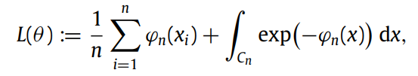
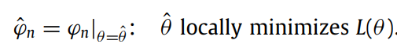
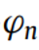
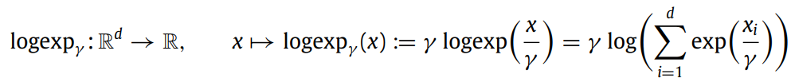
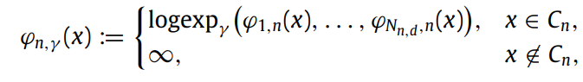
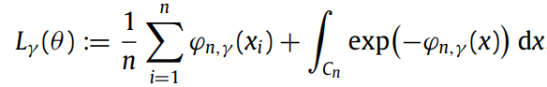
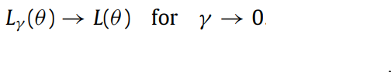
Our next step is to smoothly approximate the representation of
Notes:
심리학에서 나온 자극-반응의 이론을 토대로,

Slide 18
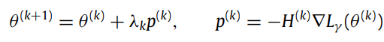
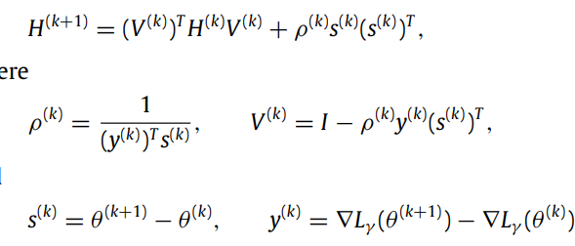
We apply an established, memory-efficient quasi-Newton method known as L-BFGS
Notes:
심리학에서 나온 자극-반응의 이론을 토대로,

Slide 19
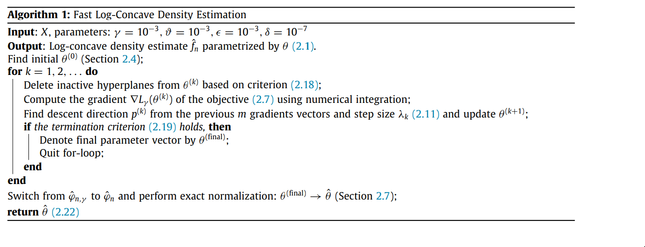
Notes:
심리학에서 나온 자극-반응의 이론을 토대로,

Slide 20
05
Source code of fmlogcondens

